Slide 1
Differentiation
Component 2

Slide 2
Get the release forms signed now.
Whenever a student joins you class, get the release form signed as part of your welcome packet.

Slide 3
Differentiation
Component 2
Show how you
Evaluate individual learning strengths and challenges
Plan and implement differentiated instruction
Analyze and modify strategies and materials

Slide 5
Weight
Component 2 is 15% of the total assessment.

Slide 7
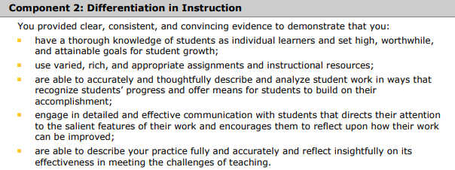

Slide 8
The component 2 guide
Component-2_Planning-Guide.pdf (nbpts.org)

Slide 9
General portfolio instructions
General Portfolio Instructions

Slide 10
Certificate-Specific Instructions
Click here
Please take ten minutes to review the certificate-specific instructions.
Write down any questions you have.
If you wish, you may ask them via voice or text chat now.

Slide 11
FAQs
Click here for the FAQ page

Slide 12
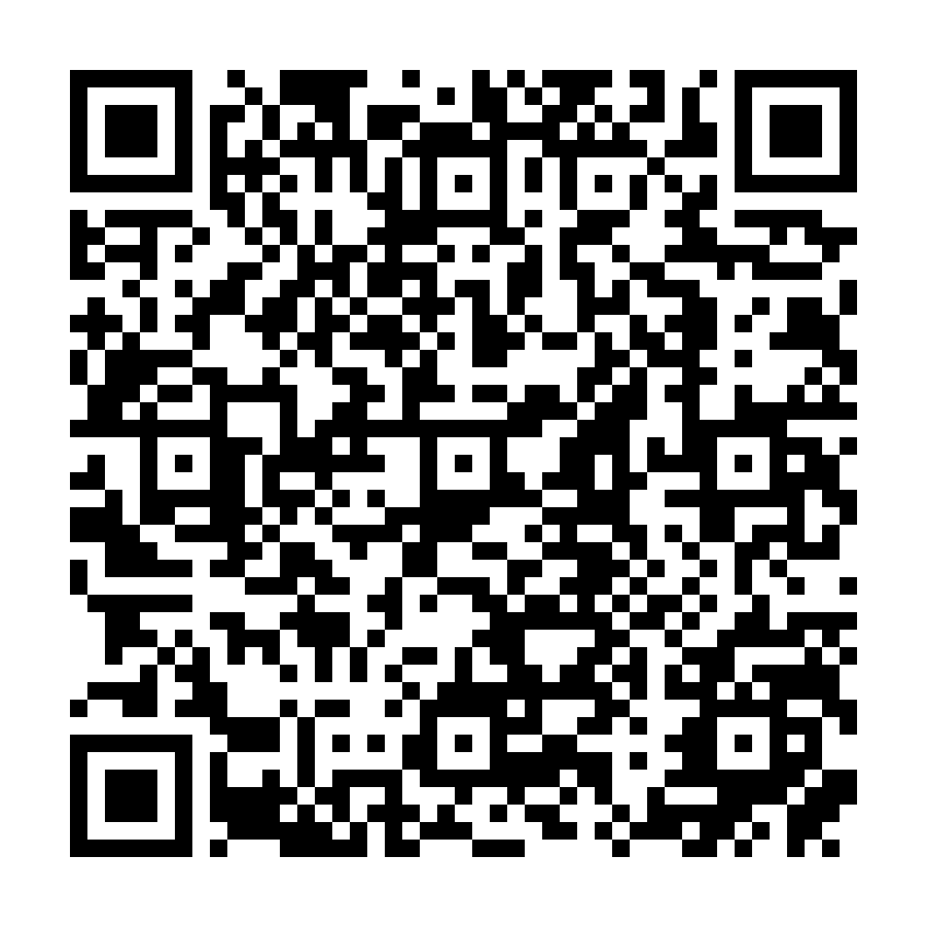
Candidate resources
First Time and Returning Candidate Resources

Slide 14
Use Online Storage for Your Portfolio
All documents and notes should be stored and organized online in a secure system using a randomized password with uppercase, lowercase, digits, and punctuation.

Slide 15
Use Online Storage for Your Portfolio
Bad things happen at the wrong time. Bags and cars get stolen, memory sticks and hard drives die, and other disasters could ruin your portfolio.

Slide 16
Use Online Storage for Your Portfolio
Why risk losing all your work and starting over or losing out when you can easily and cheaply back up your work online?

Slide 17
Helpful Tools for Portfolios
An online notetaking system for organizing your portfolio
Notion
Evernote
Google Keep
MS OneNote
A quality scanner or scanning app
A cloud-based backup system
Dropbox
Google Drive
OneDrive
iCloud

Slide 18
Helpful Tools for Portfolios
A great to-do list app that lets you divide your list by components
Todoist
A system to deal with distractions and stay focused
The Pomodoro Technique
Getting Things Done by David Allen
A way to connect your to-do list and the Pomodoro Technique
Pomodone

Slide 19
Thank you for joining us today!
All the best on your NBCT journey!
Remember to get release forms signed!
Back up everything!
Images are screenshots from NBPTS.org or Pixabay.com.

